Slide 1
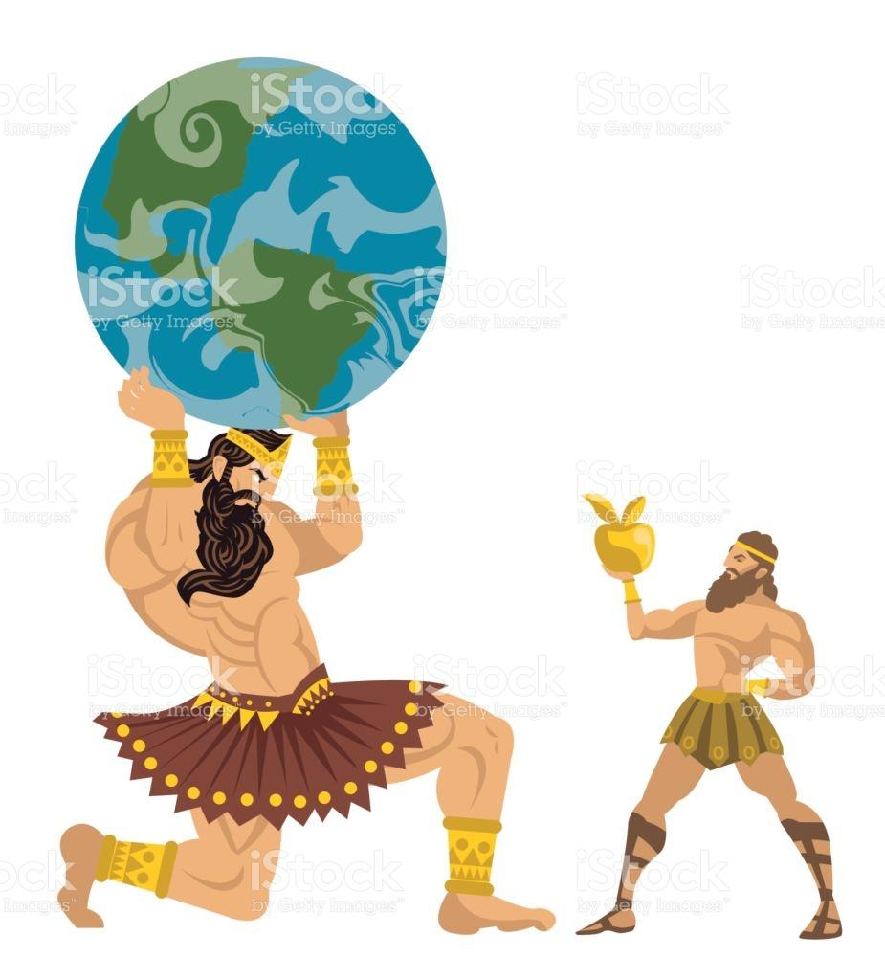
Olympian Monthly !
Hercules named after Hera? Possibly Hera’s offspring…. Pg.13 OMG !
Hercules Committed Theft !?
Atlas, a titan gets fooled by a god ? Pg.4
Hercules committed theft !?
Atlas a titan, gets fooled by a god.... Pg.4
Lyla a Dryad, in love with Atlas! Is new found love in the air ...... Pg.6 Ooooo
Could Hercules be named after Hera? Pg. 13

Slide 2
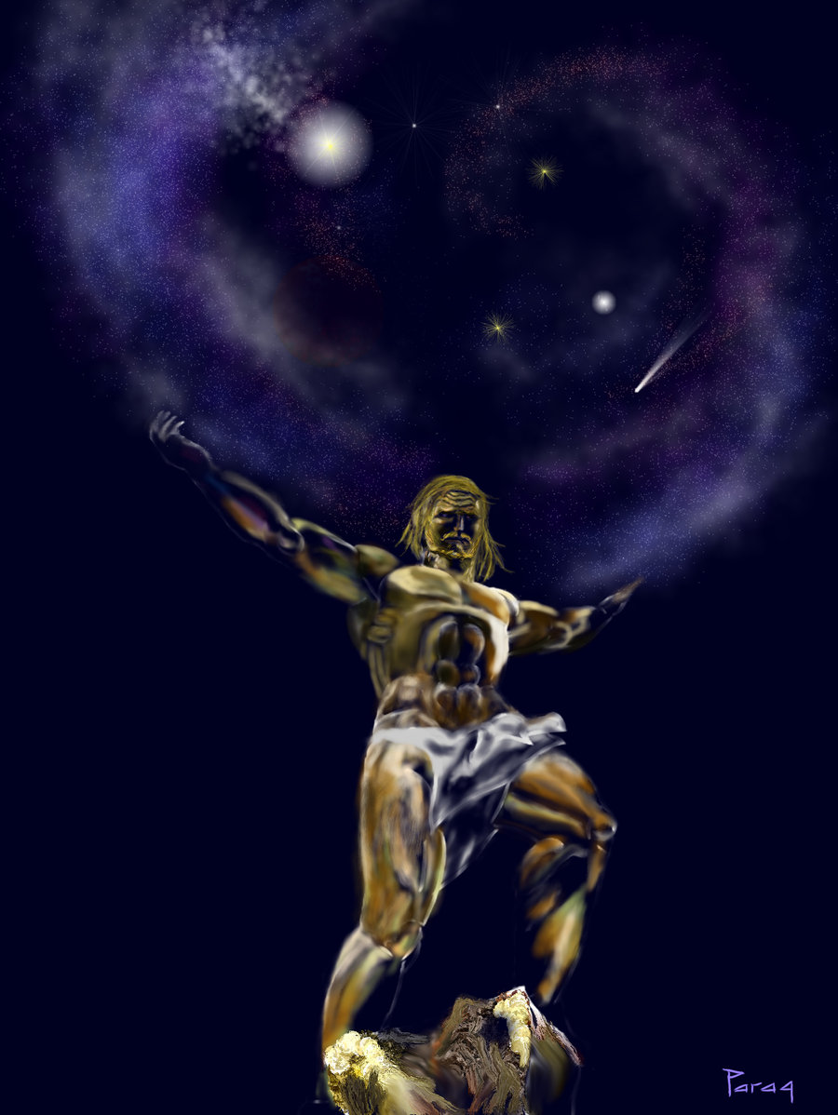
Hercules Eleventh Labor: The Apples of the Hesperides

